Slide 1
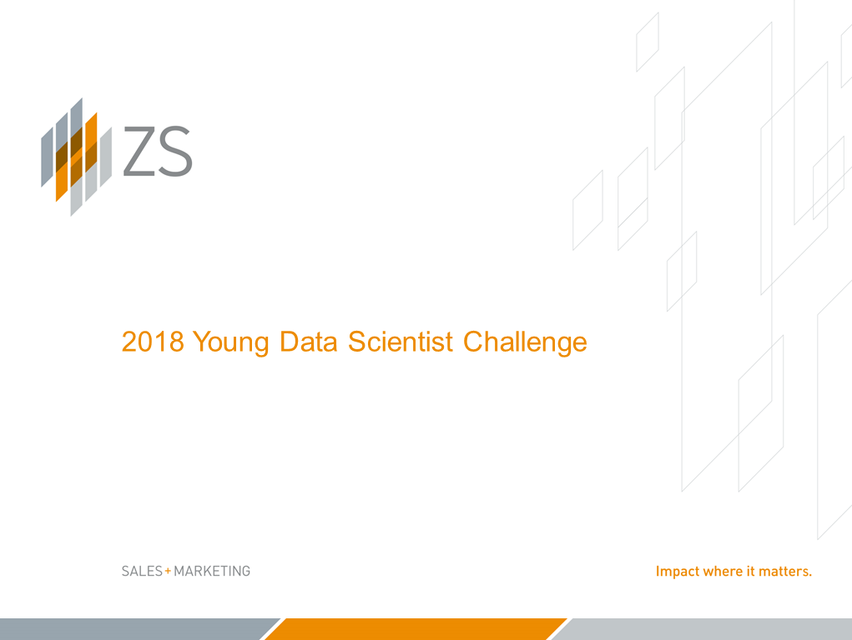

Slide 2
Sales Forecasting of global premium electronics manufacturing company
Mekktronix

Slide 3
Company background
Problem Statement
Company Background-
‘Mekktronix’ is a global premium electronics manufacturing company which provides electronic devices across globe through their large distributor channel.
Problem Statement
Recently company is observing lot of fluctuations in their demand forecasting across geographies affecting their revenue. The company has reached out to build a machine learning driven forecasting solution to predict sales accurately.
.

Slide 4
Problem Solving Methodology
Model Evaluation
Data Preparation
Model Building
Data Understanding
Business Understanding
Result Interpretation

Slide 5
Business Understanding
Recently Mekktronix is observing lot of fluctuations in their demand forecasting across geographies affecting their revenue. The company has reached out to build a machine learning driven forecasting solution to predict sales accurately. To test the power of AI/ML, company has provided data sales data.
The company has asked for forecast at Country × Product × Month resolution. The forecasting horizon varied from {3, 9, 12} months based on country and product as shown in Figure 5. For example, for Denmark with product_ID 2 forecasting horizon is 12 months with monthly sales to be reported from Apr 2016 to March 2017.

Slide 6
Data Understanding
Basically, these are the datasets provided-
Format of sales dataset provided at merchant × Week level (“yds_train2018.csv”)
Holiday dataset format (“holidays.csv”)
Expense dataset format (“promotional_expense.csv”)
From these datasets few things come out very easily-
Combination of Country × Product and Training Horizon
Forecasting summary for test dataset

Slide 7
Data Preparation
Converted the entire different time components together as date for easier analysis
Tried to find the sales type for every countries
Prepared data for these columns for forecasting
Year
Month
Product_ID
Country
Sales

Slide 8
Model Building
We have used Holt Winters Method for forecasting.
Holt-Winters is a model of time series behavior.
Forecasting always requires a model, and Holt-Winters is a way to model three aspects of the time series: a typical value (average), a slope (trend) over time, and a cyclical repeating pattern (seasonality).
Holt-Winters uses exponential smoothing to encode lots of values from the past and use them to predict “typical” values for the present and future.

Slide 9
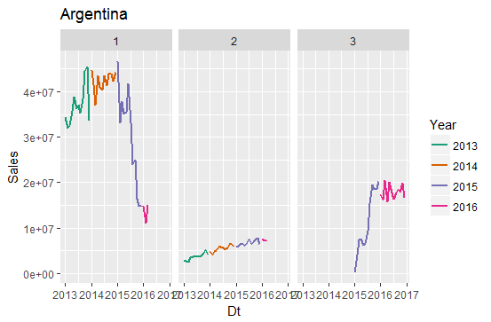
Result Interpretation

Slide 10
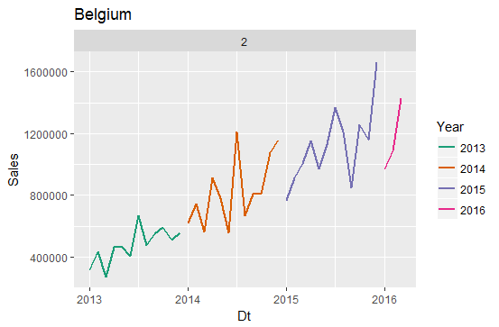

Slide 11
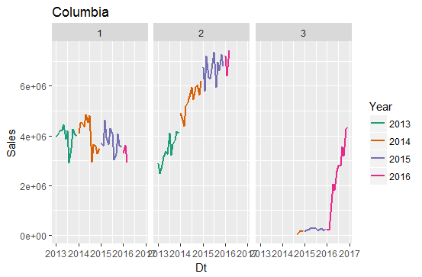

Slide 12
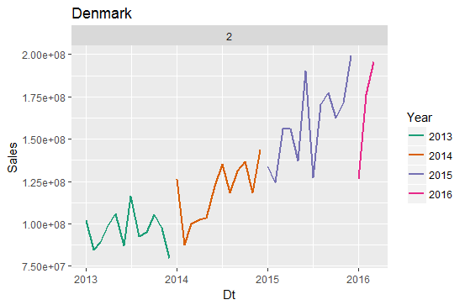

Slide 13
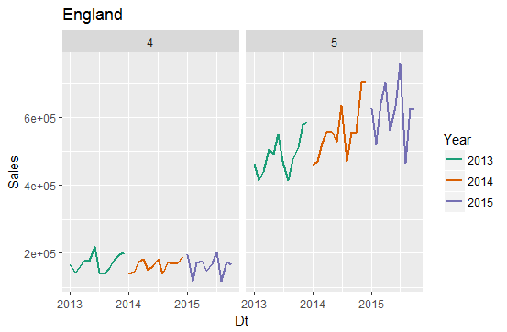

Slide 14
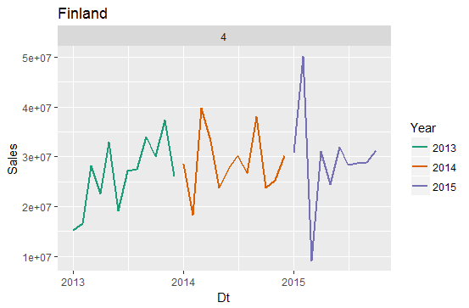

Slide 15
